Slide 1
Amazon Sales Report Analysis

Slide 2
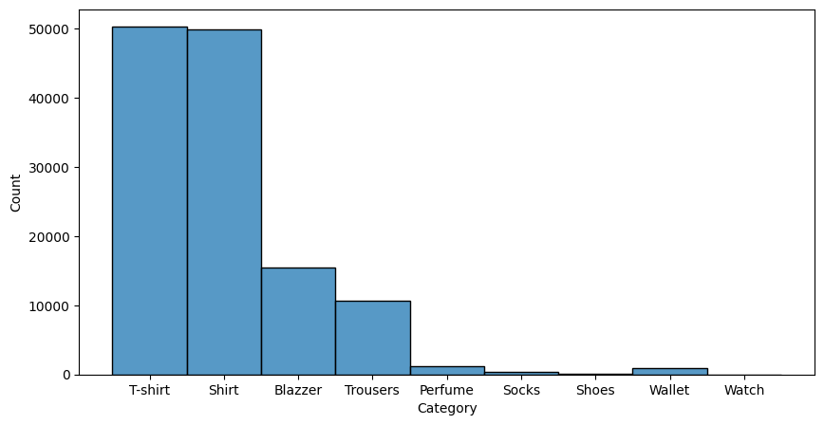
Top Products Sold

Slide 3
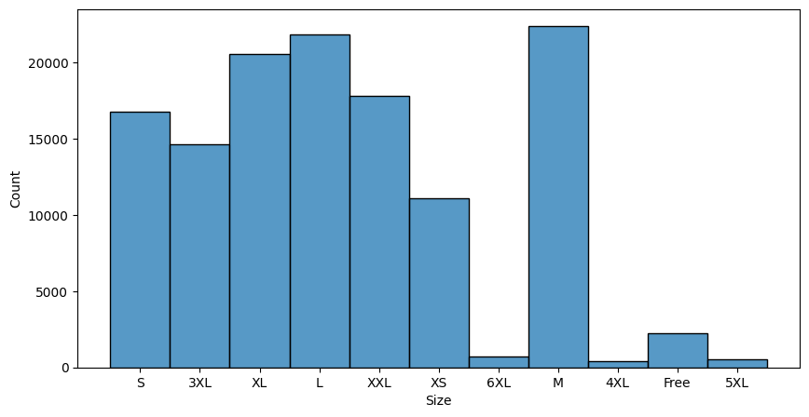
Top Product Sizes Sold

Slide 4
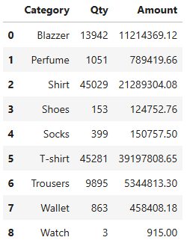
Total Quantity & Amount of Products Sold

Slide 5
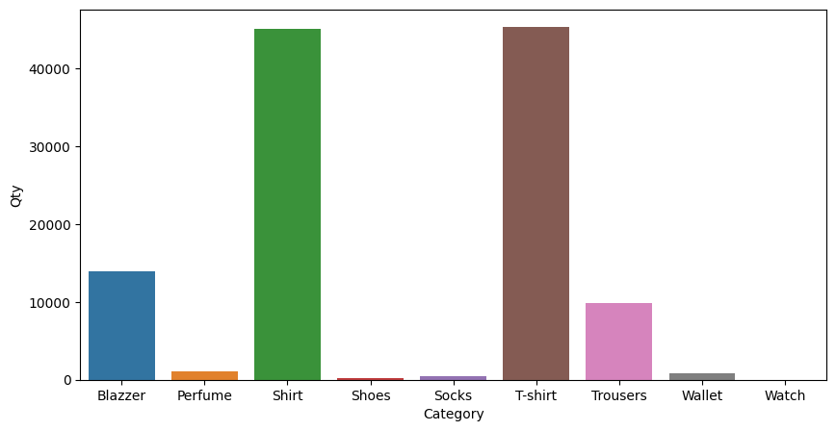

Slide 6
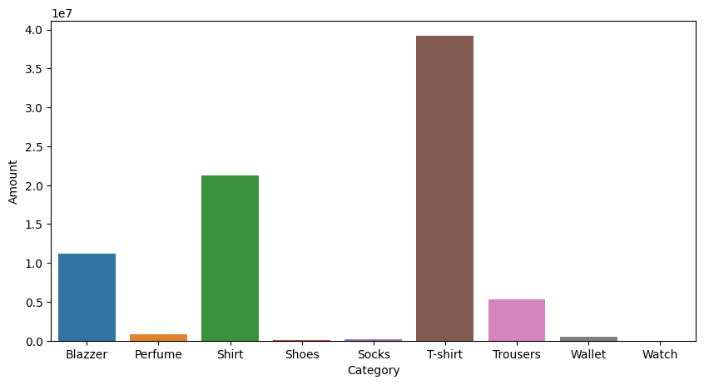

Slide 7
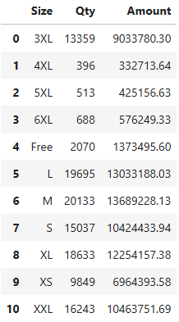
Total Quantity & Amount of Products’ Sizes Sold

Slide 8
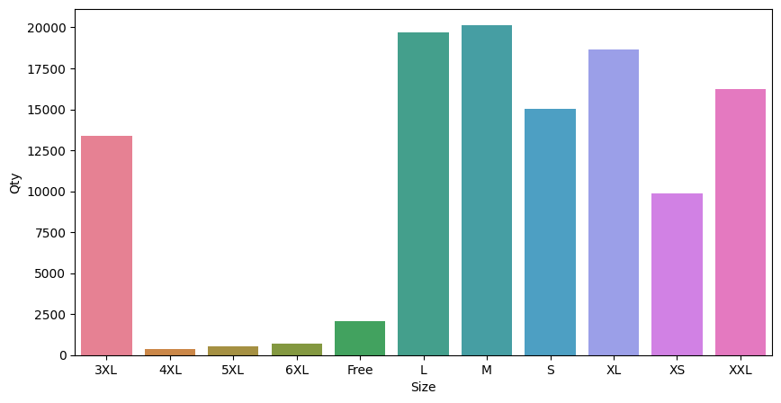

Slide 9
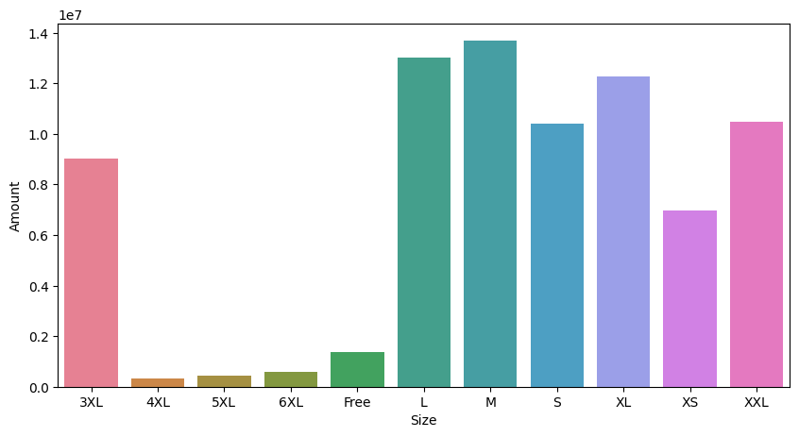

Slide 10
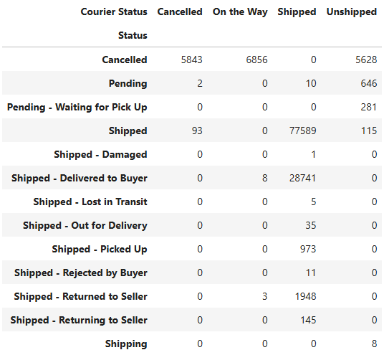
Shipping
Efficiency

Slide 11
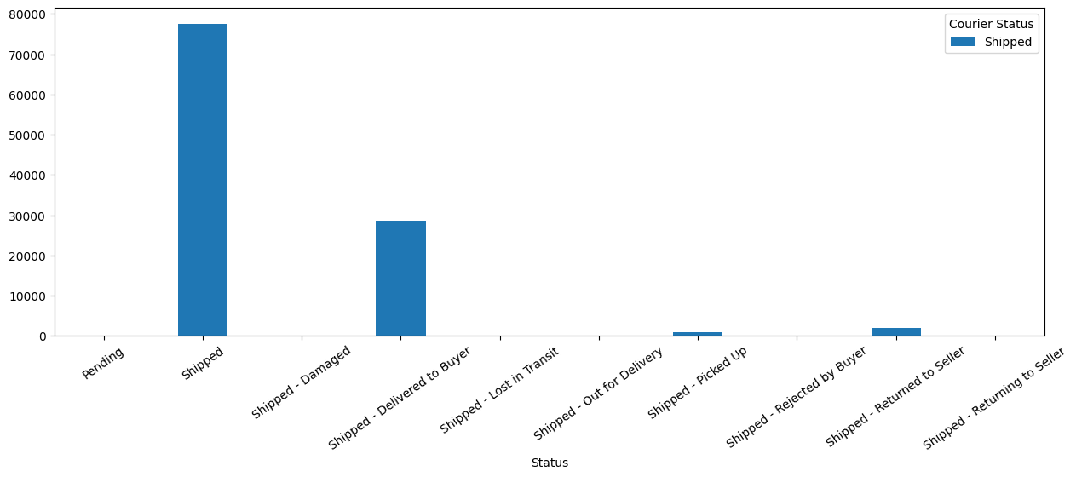
Orders Actually Shipped

Slide 12
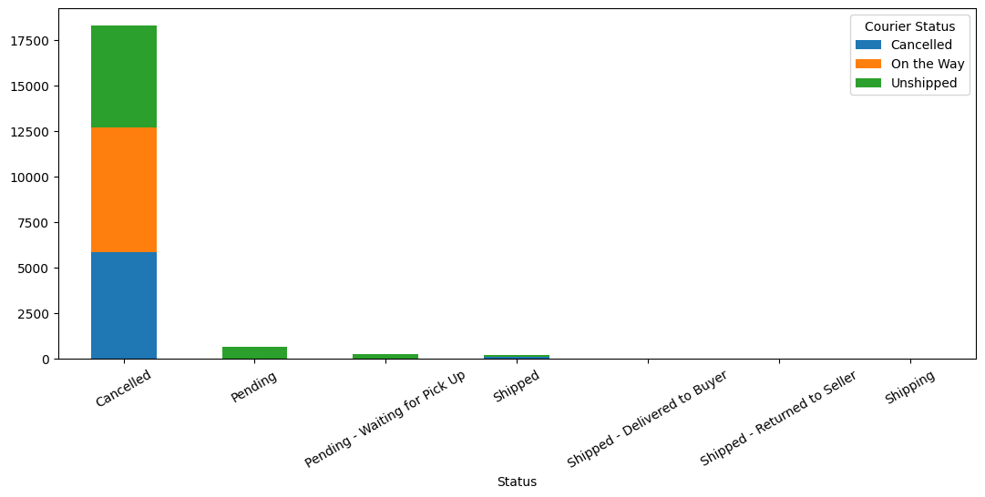
Orders Cancelled

Slide 13
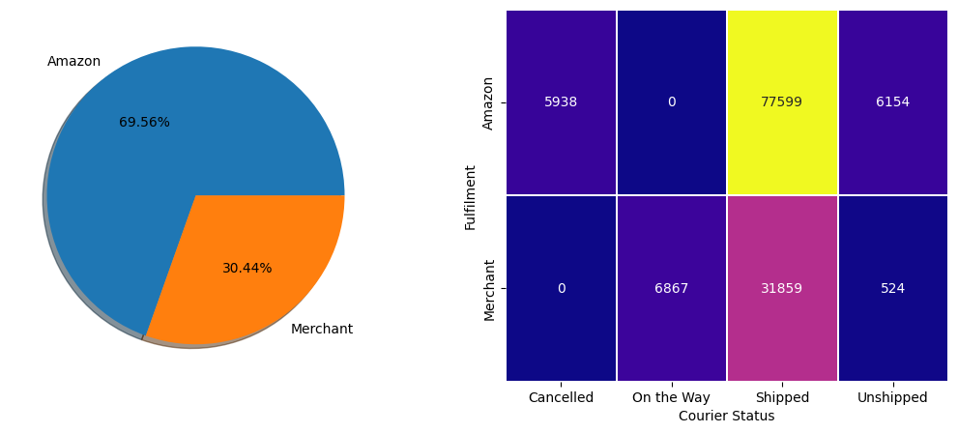
Merchant’s Efficiency in Delivery

Slide 14
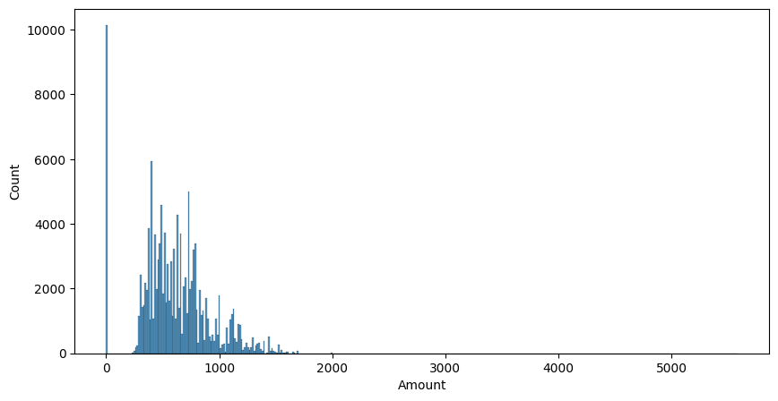
Price Distribution

Slide 15
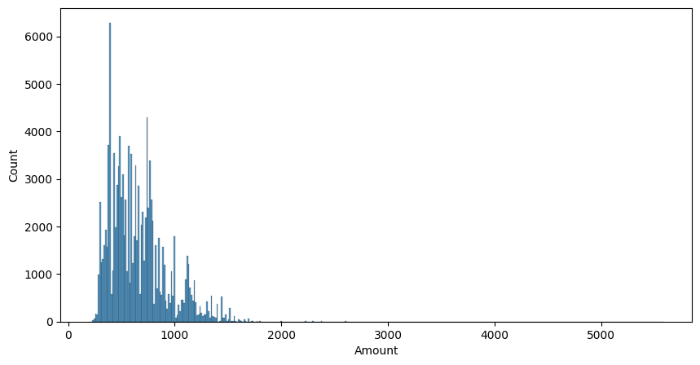
Price Distribution of Non-Zero Prices

Slide 16
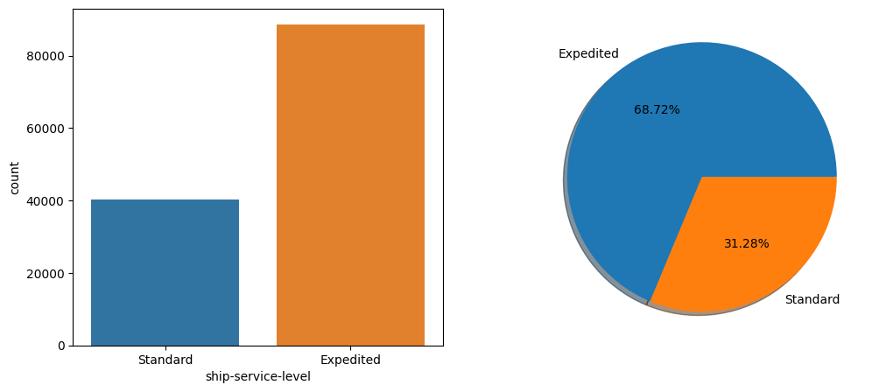
Level of Shipping

Slide 17
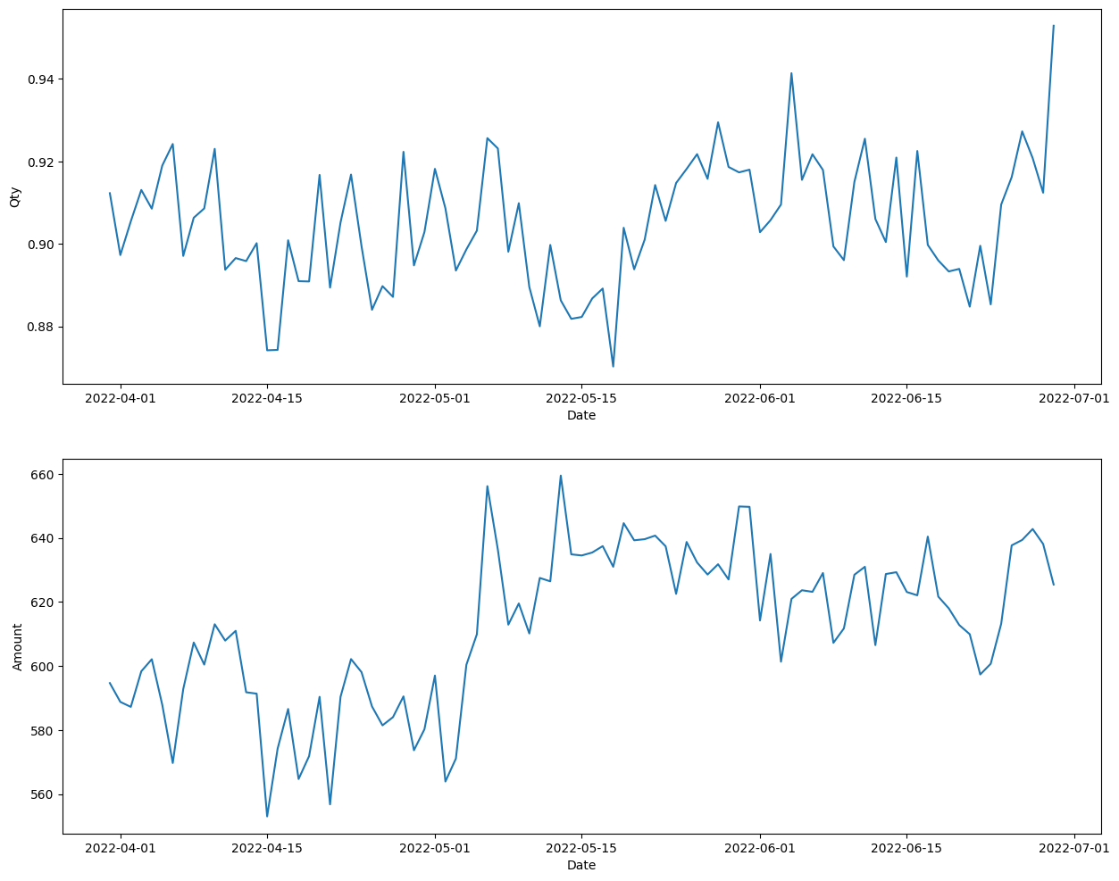
Sales Trend

Slide 18
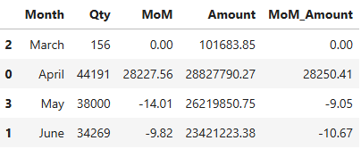
Month-on-Month Growth

Slide 19
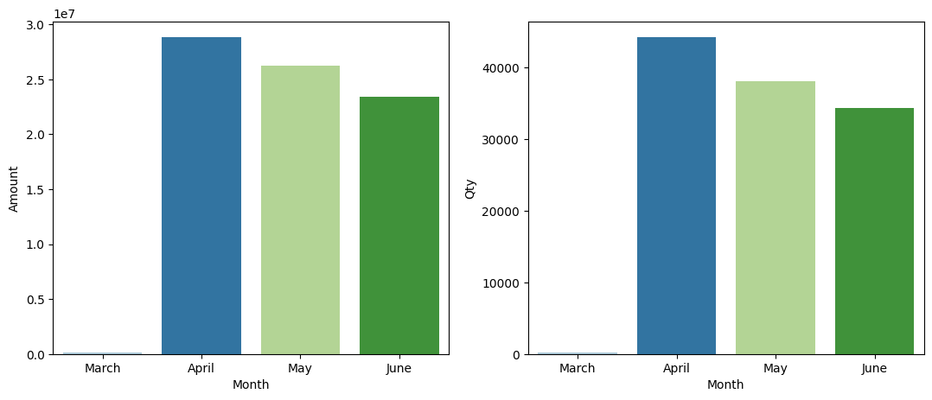

Slide 20
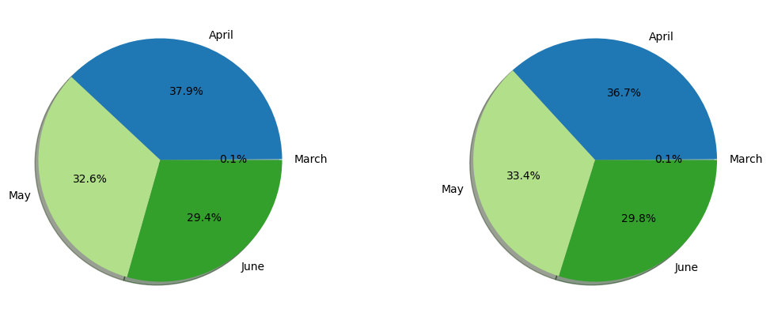

Slide 21
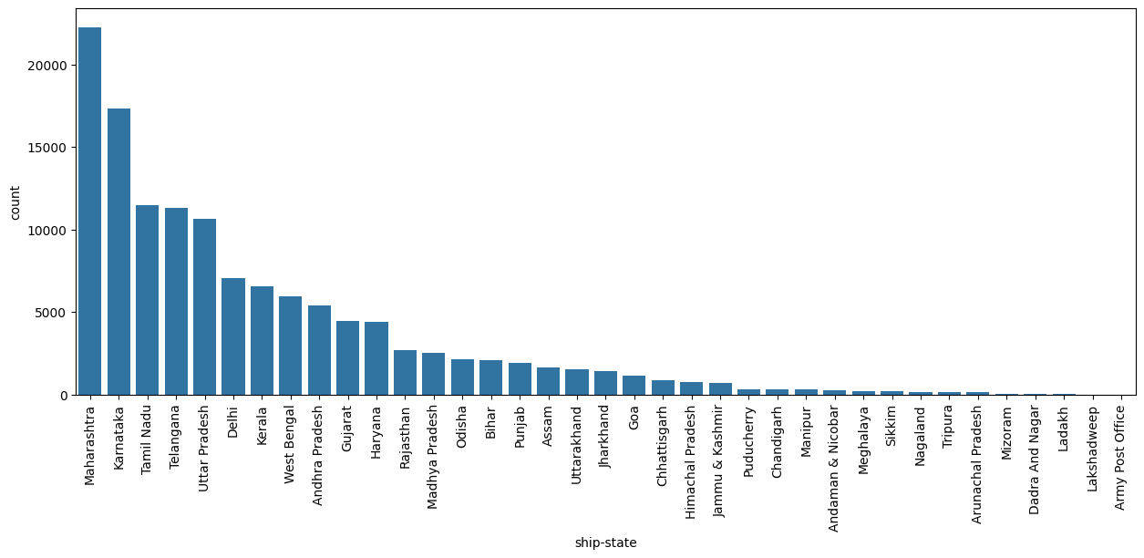
Top States

